Slide 1
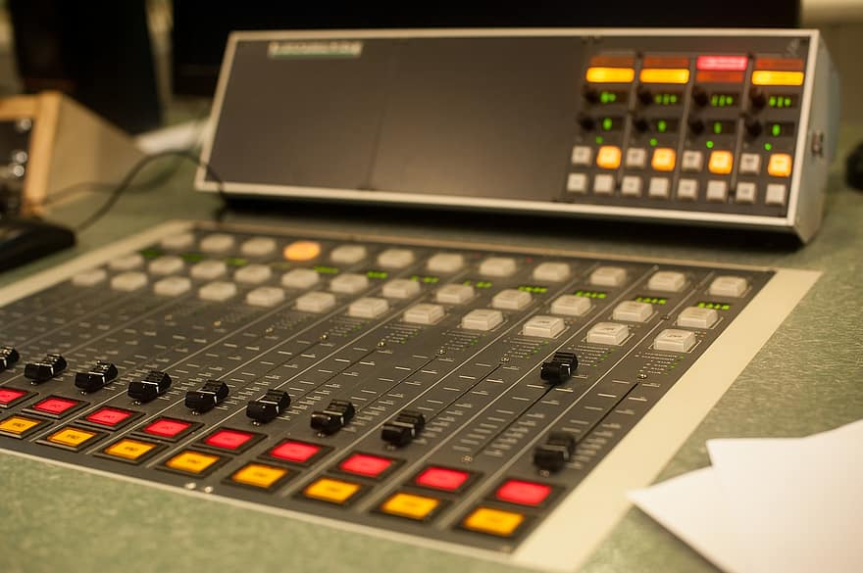
Community Airtime
Zoom workshop
With David Bellew & Padraig Quigley

Slide 2
Welcome
Introduction

Slide 3
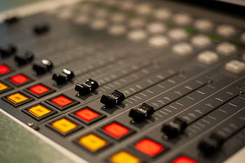
Course Content
Audio and video settings
Chat functions, share screen, play music
Equipment choices: microphones/ webcams
Organizing your own meeting
Host settings
Breakout rooms
How to record a meeting

Slide 4
Zoom meeting toolbar

Slide 5
Zoom meeting toolbar exercises
Mute/unmute microphone
Turn on off video camera
Say hello in the chat
Rename e.g David Bellew - Dundalk FM
Reactions/ raise hand

Slide 6
Screen Sharing
Share a website
YouTube video (with sound)
Word/ libre office

Slide 7
Breakout rooms
Manual / auto assign
Automatic return
Broadcast message

Slide 8
Advanced audio visual settings

Slide 9
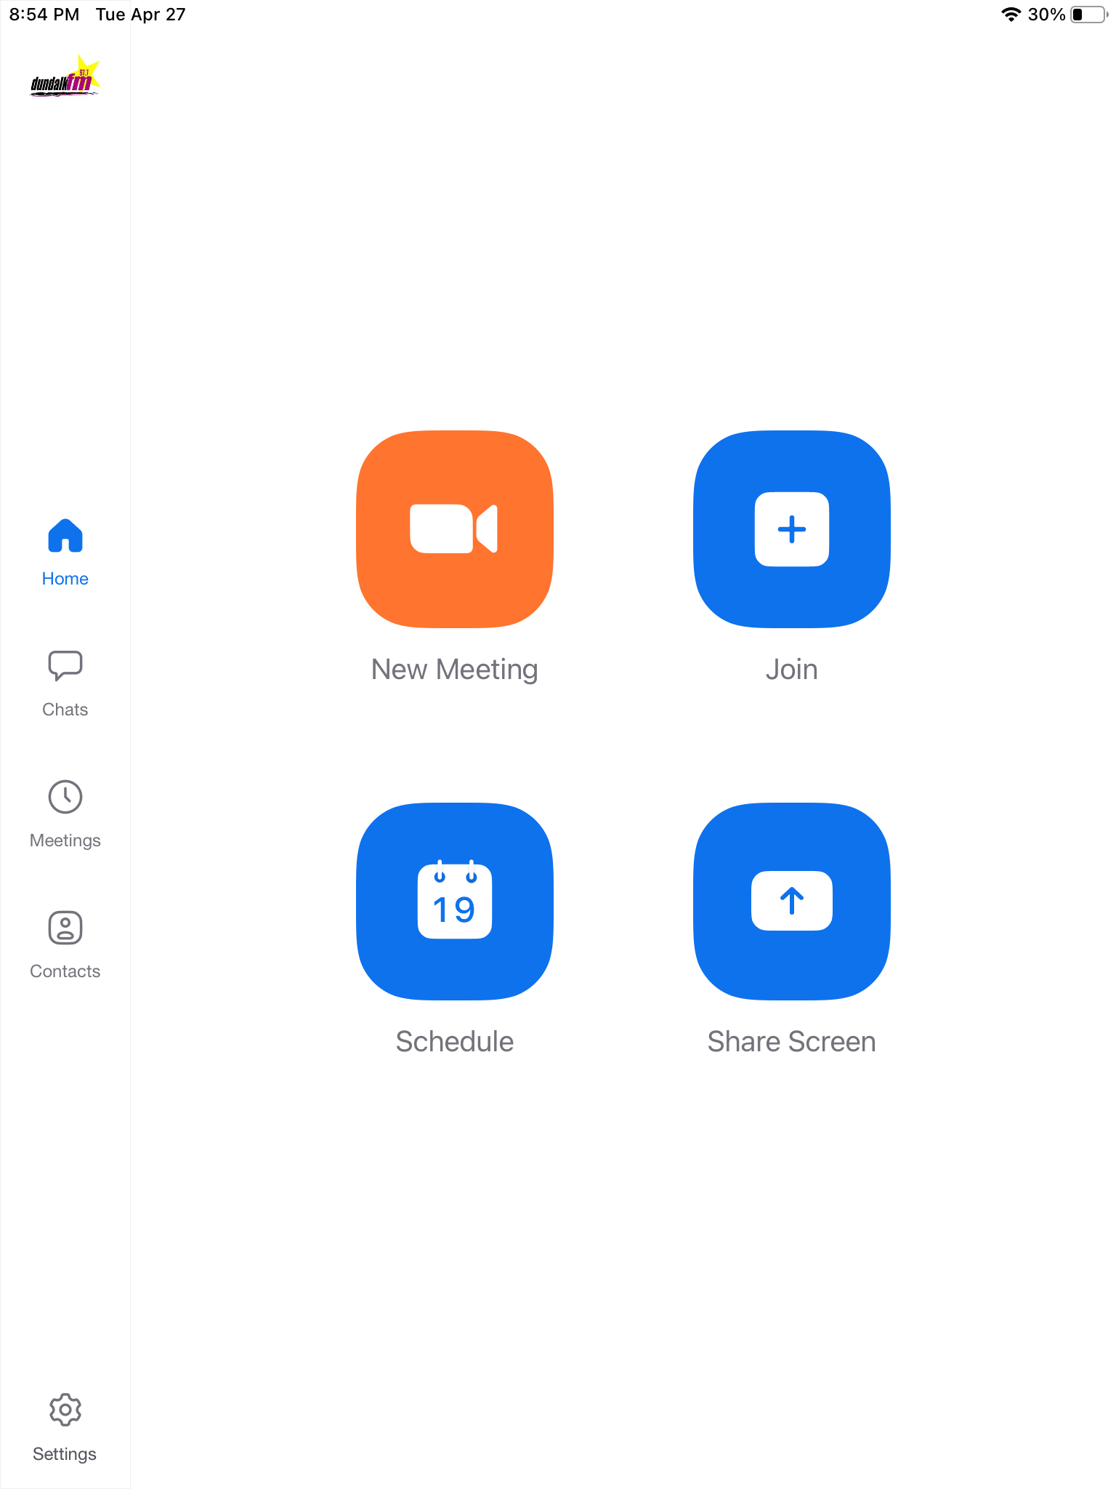
Setting up your own meeting

